Slide 1

Machine Learning with PyCaret
Moez Ali
April 13, 2022

Slide 2
Agenda
Introduction
Machine Learning Life Cycle
PyCaret
Demo
Q&A

Slide 3





About me
Background: Finance + Economics + Computer Science + Data Science
Industry: Healthcare + Education + Consulting + Fintech + Retail
Work: Asia + Middle East + East Africa + North America
Open-Source: PyCaret
https://www.linkedin.com/in/profile-moez/
https://moez-62905.medium.com/
https://twitter.com/moezpycaretorg1
moez.ali@pycaret.org

Slide 4
Important Links
Official: https://www.pycaret.org
GitHub: https://www.github.com/pycaret/pycaret
LinkedIn: https://www.linkedin.com/company/pycaret
YouTube: https://www.youtube.com/channel/UCxA1YTYJ9BEeo50lxyI_B3g
Medium: https://moez-62905.medium.com/
Slack: https://join.slack.com/t/pycaret/shared_invite/zt-row9phbm-BoJdEVPYnGf7_NxNBP307w
Demo: https://www.github.com/pycaret/pycaret-demo-inform

Slide 5
Machine Learning Life Cycle
Deployment & Monitoring
Model Training & Selection
Deployment & Monitoring
Business Problem
Data Sourcing & ETL
Exploratory Data Analysis (EDA)
Data Prep.
Model Training & Selection
Data Prep.

Slide 6
Data Prep, Model Training and Selection
Data
Train Test Split
Train
Missing Values Imputation
Feature Scaling
Encodings
Feature Engineering
Test
Final Pipeline
Deploy
Monitor
Cross Validation Environment
Model Training
Model Tuning
Model Selection
Model Ensemble
Optional

Slide 7
Challenges of Machine Learning Lifecycle
Machine Learning is an iterative process. It is very time consuming.
Right tooling in the hands of right people is very important.
Creating a seamless pipeline is hard. Managing it in production is harder.
Focus on end-goal and solving business problems can take a backseat within small teams with increasing technical debt.
Scalability is not just desirable, but it is very much needed.

Slide 8



What is PyCaret?
PyCaret is an open source, low-code machine learning library and end-to-end model management used to automate machine learning workflows. It is commonly used for rapid prototyping and deployment of ML pipelines.
EASY TO USE
PRODUCTIVITY TOOL
BUSINESS READY

Slide 9






PyCaret Features
Data
Preparation
Model
Training
Hyperparameter
Tuning
Analysis &
Interpretability
Model
Selection
Experiment
Logging

Slide 10
Machine Learning use-case supported:
Classification
Regression
Time Series
SUPERVISED
Clustering
Anomaly Detection
Association Rule Mining
Natural Language Processing
UNSUPERVISED

Slide 11
Impact of PyCaret
Cumulative lines of code
Machine Learning Workflow Level

Slide 12
Some cool numbers
3M+
5,500+
71
2,200+
Downloads
Git Stars
Contributors
Commits

Slide 13











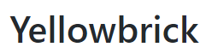
PyCaret Integrations

Slide 14

Companies using PyCaret

Slide 15
PyCaret Roadmap (3.0)
Object Oriented API
To allow switch b/w functional and OOP API in the same environment.
Preprocessing Re-write
Faster + better + compatible with sklearn >= 1.0
ML Parallelization
compare_models will be distributed on cluster (spark + dask + ray)
Time Series Module
pycaret-ts-alpha will be merged into master

Slide 16
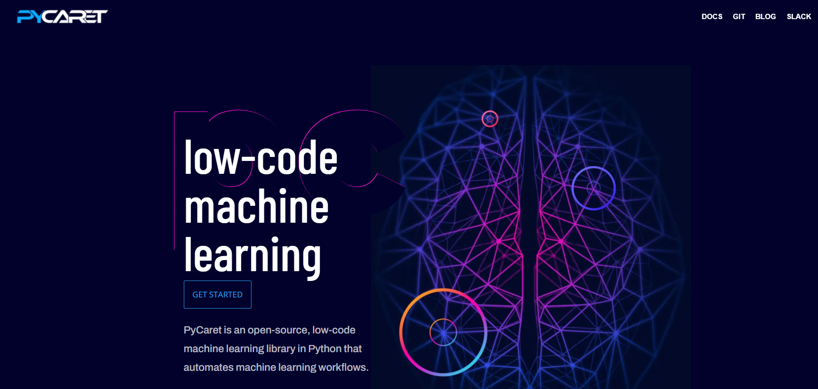
New look!

Slide 17
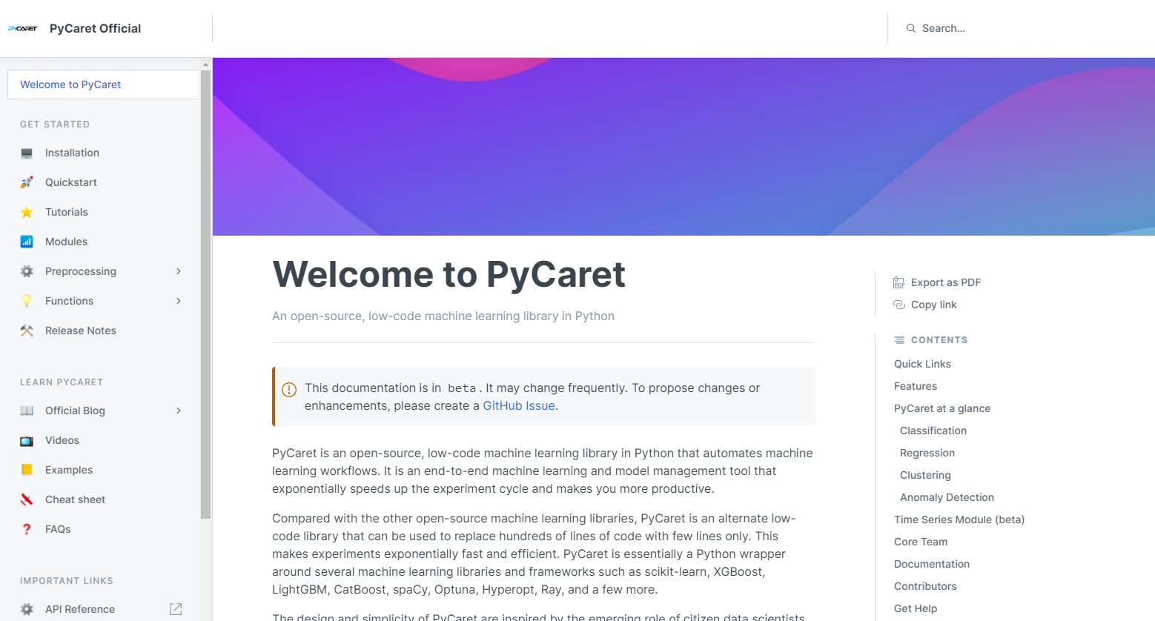
New docs! pycaret.gitbook.io

Slide 18
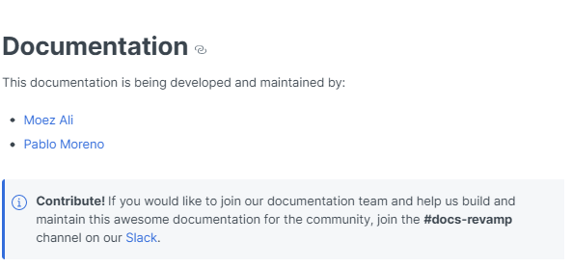
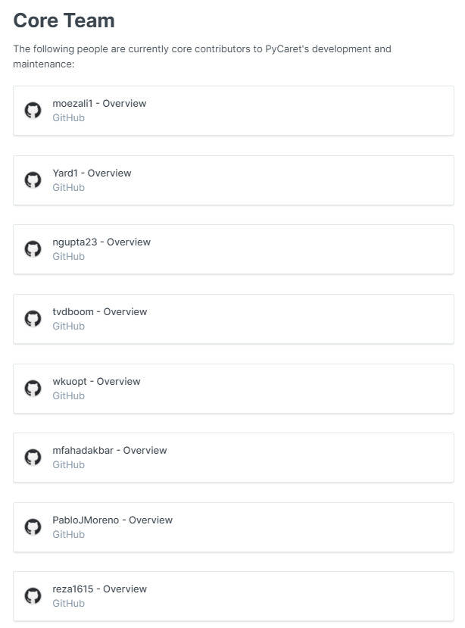
THANK YOU TO ALL CONTRIBUTORS!

Slide 19
Demo
This presentation and all Notebooks are available here:
https://www.github.com/pycaret/pycaret-demo-pydata

Slide 20
APPENDIX

Slide 21
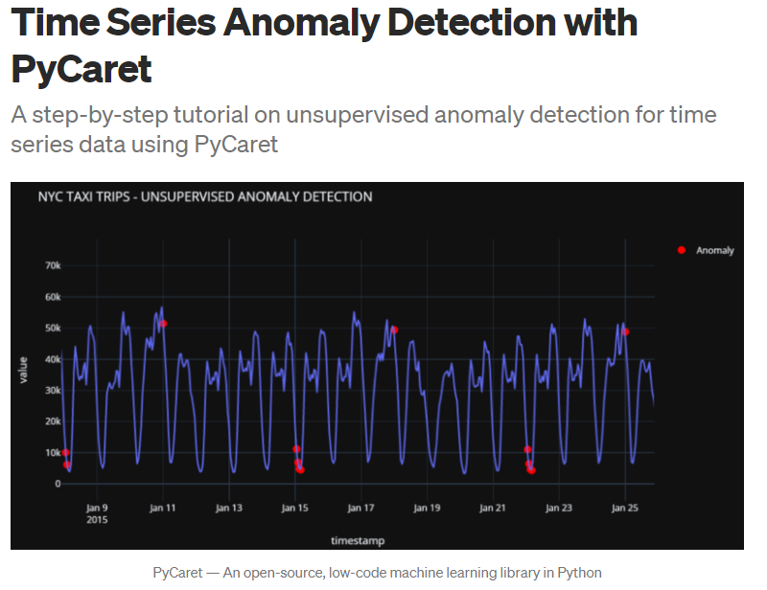
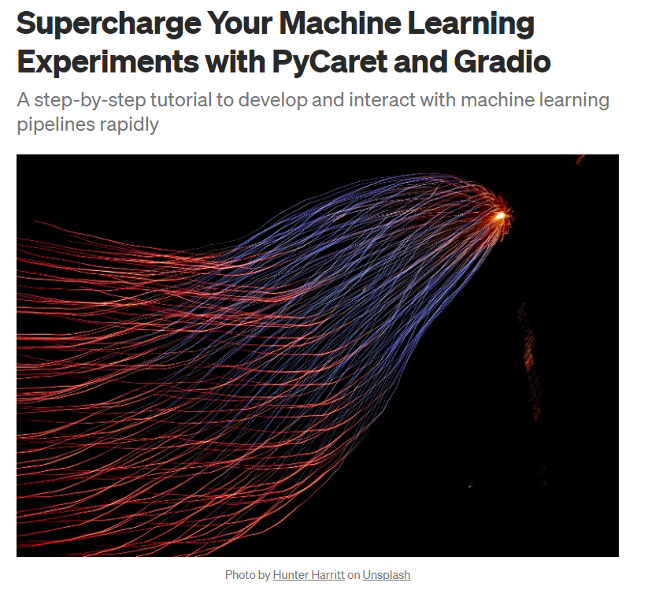
Resources

Slide 22
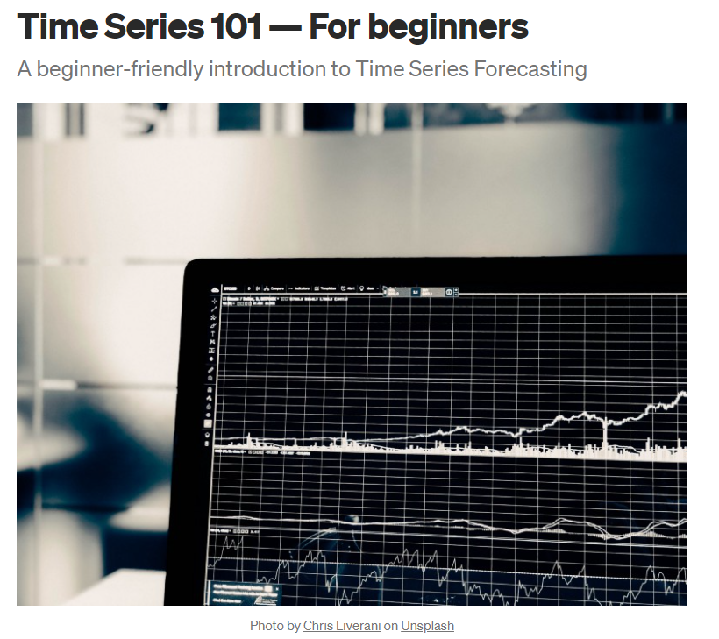
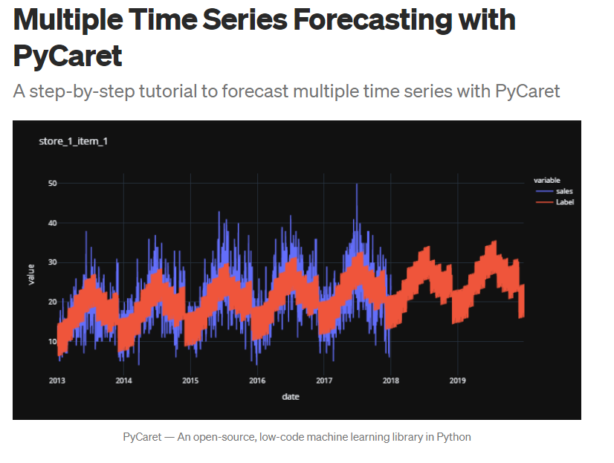
Resources (cont.)

Slide 23
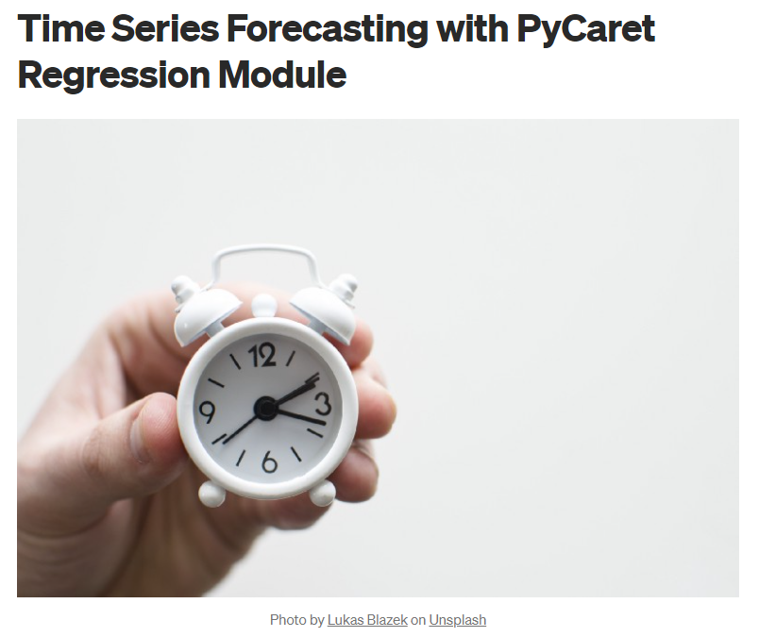
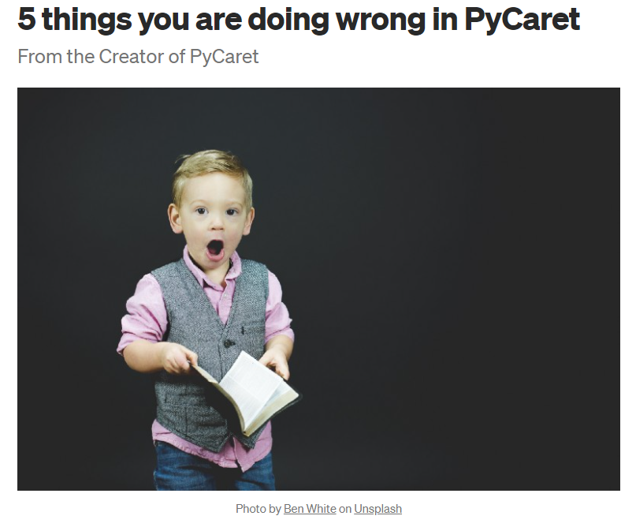
Resources (cont.)

Slide 24
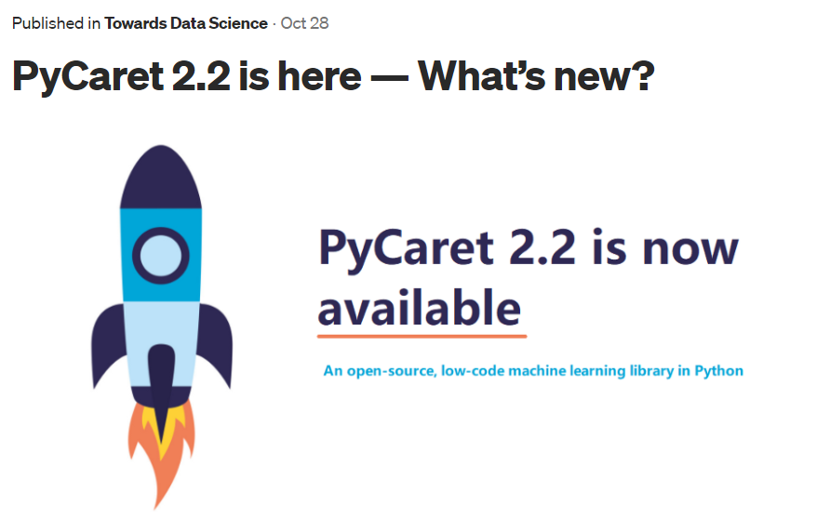
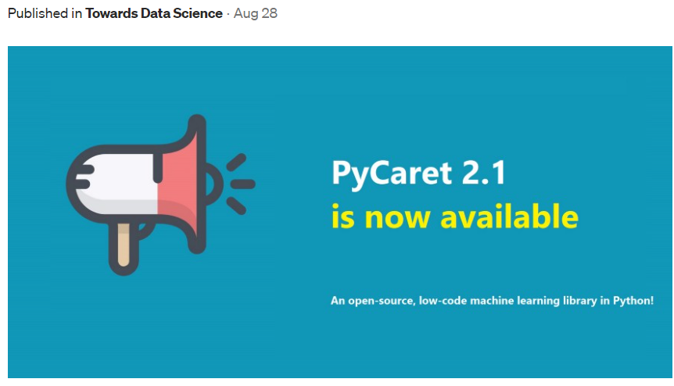
Resources (cont.)

Slide 25
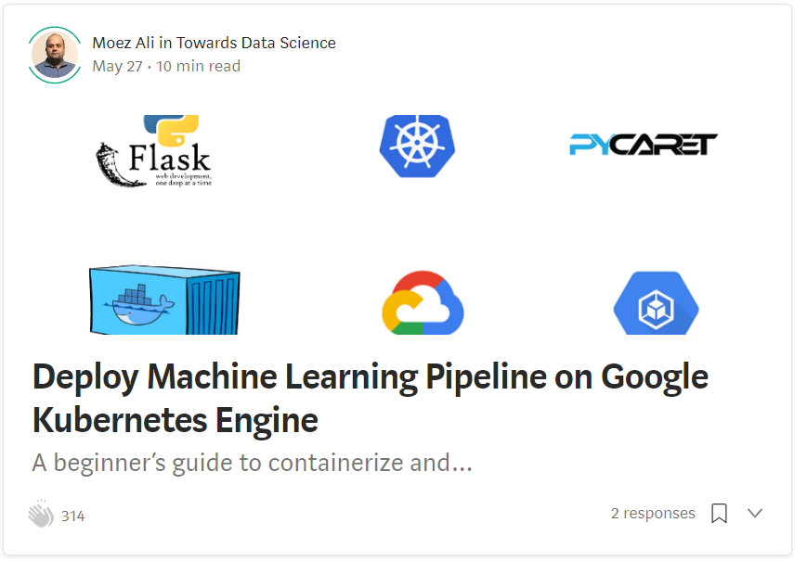
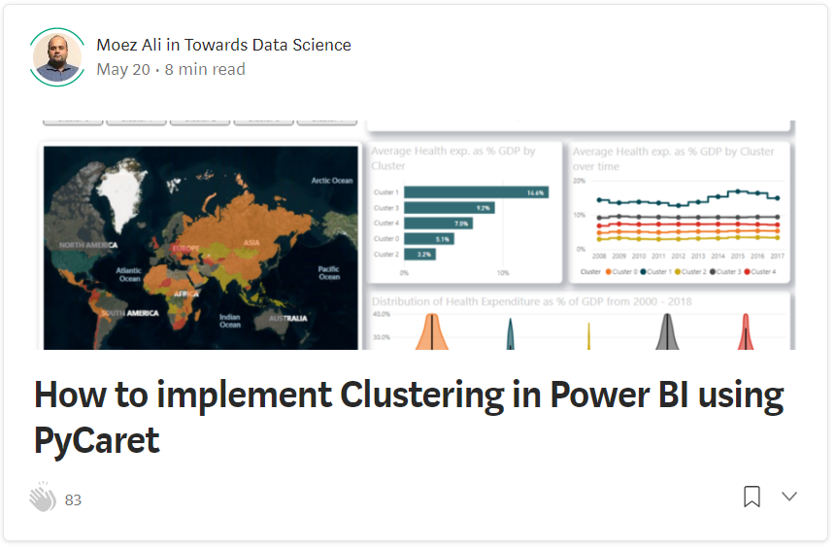
Resources (cont.)

Slide 26
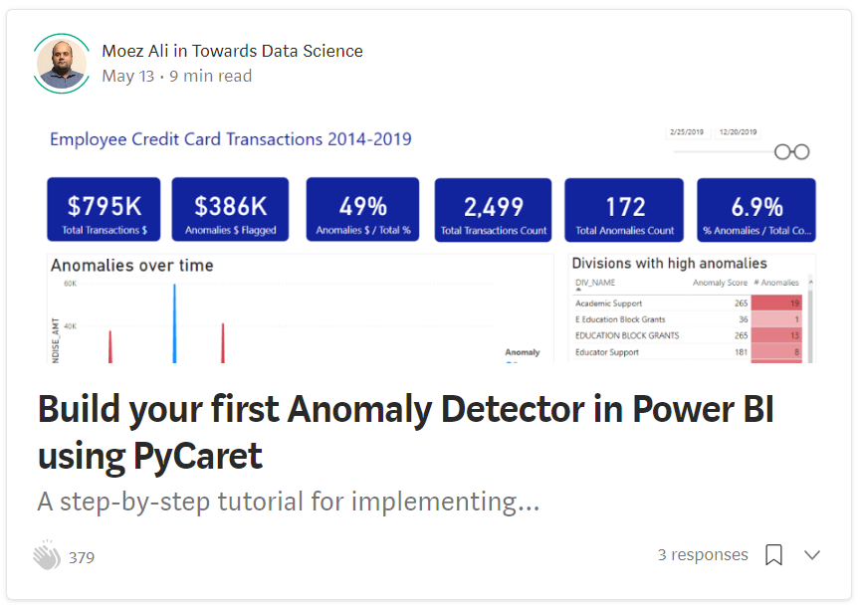
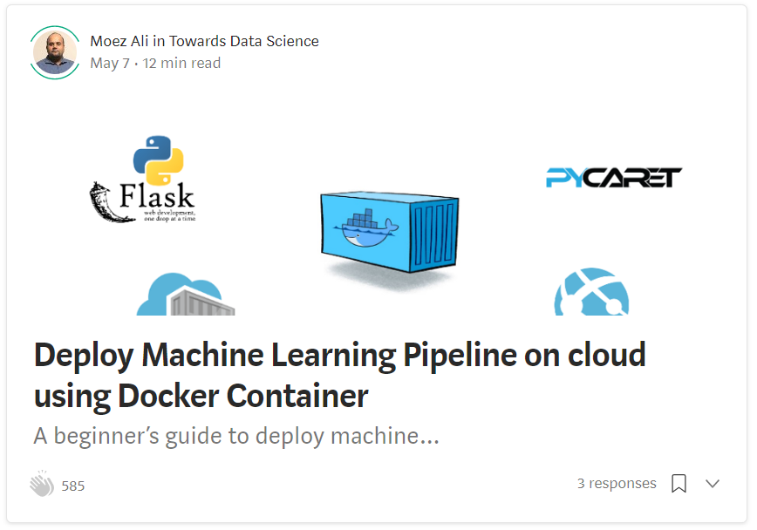
Resources (cont.)

Slide 27
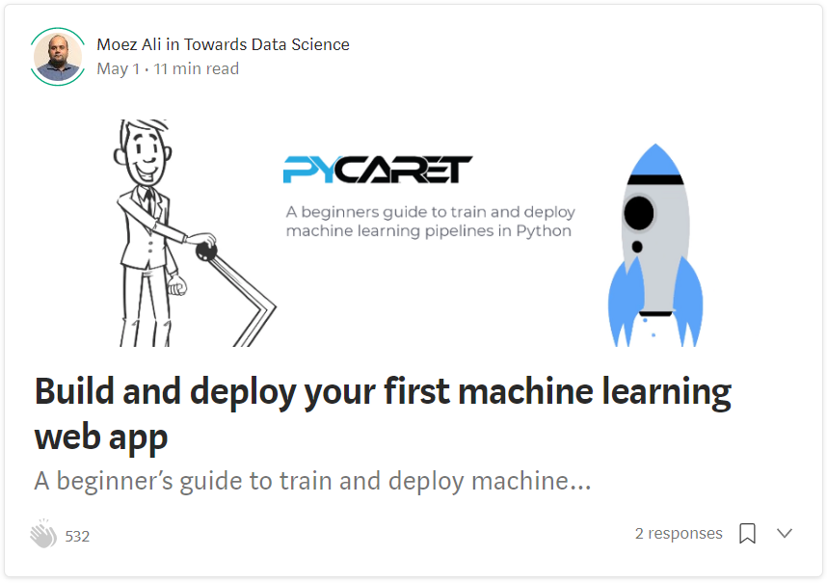
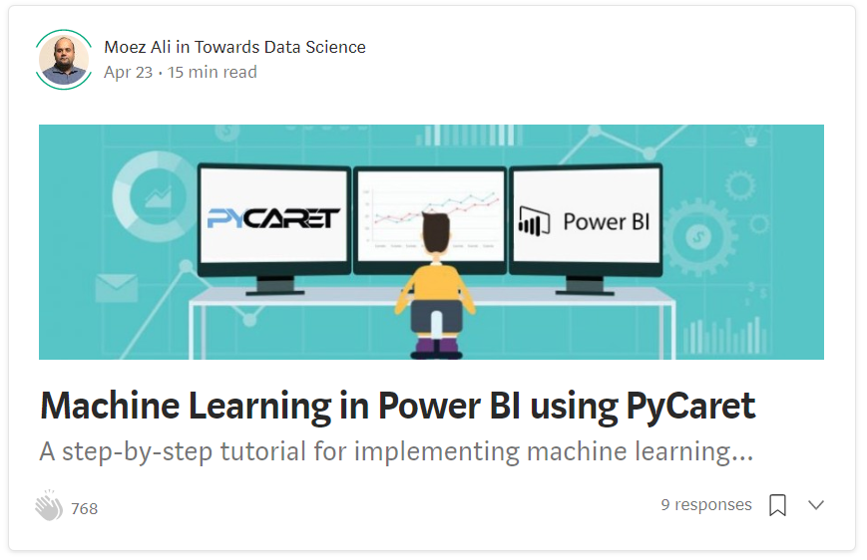
Resources (cont.)

